Slide 1

Accommodation Establishments
Use case
Sebastian Wójcik, PhD
Statistical Office in Rzeszów
Statistics Poland
Madrid, 6th July 2023

Slide 2
Contents
Processing and data linkage methods
Results
Surveys of accommodation establishments
2

Slide 3
Centre of Statistics of Sport and Tourism
Statistical Office in Rzeszów
Surveys of tourism
demand side of tourism
supply side of tourism
2

Slide 4
Demand side of tourism
Tourist accommodation facilities regardless of the type of facility, owner and location, as well as facilities for other purposes (not related to tourism) that are temporarily used by tourists (e.g., dormitories, sports and recreation centers).
Tourist accommodation facilities classified in the following activity groups according to NACE 2007:
55.1 - hotels and similar acommodation,
55.2 – holiday and other short-stay accomodation,
55.3 – camping grounds, recreational vehicle parks and trailer parks.
The survey covers 20 types of tourist accommodation facilities.
4

Slide 5

KT-1
monthly survey,
census survey,
survey frame – 12 thus. of units
compulsory survey,
tourist accommodation establishments possessing 10 or more bed places.
KT-2
annual survey,
Survey sample selection- sample of 2000 units,
Survey frame – Ewidencja Obiektów Turystycznych (EOT)
compulsory survey,
tourist accommodation establishments below possessing 10 bed places
Scope
Type of facility, nominal number of beds, domestic tourists using accommodation and accommodation provided to them, foreign tourists and accommodation provided to them by country.
Every 4 years information is collected on facilities for the disabled, sports, recreational and conference facilities.
5

Slide 6
Data sources to create survey frames
Centralny Wykaz Obiektów Hotelarskich (CWOH Register)
The Central List of Hotel Facilities is maintained on the basis of the Act on Hotel Services and Tourist Guides and Tourist Pilot Services of 29 August 1997. On the basis of information transmitted electronically by voivodship marshals concerning categorised hotel facilities in the voivodship, the Central List of Hotel Facilities is published.
Ewidencja Obiektów Turystycznych
Persons providing hotel services in facilities other than hotel facilities referred to in Article 35(1) and Article 36 of the Act of 29 August 1997 on tourism services are required, prior to the commencement of operations, to notify such facility to the register kept in the municipality competent for the location of the facility.
This obligation applies to all those who provide hotel services in facilities which are not hotel facilities (i.e. are not: a hotel, a motel, a boarding house, a campsite, a youth hostel, a hostel).
5

Slide 7








International projects
ESSnet Big Data is a project implemented within the European Statistical System (ESS) jointly by 28 partners. Its aim was to integrate big data into the regular production of official statistics, through pilot studies of the potential of selected big data sources and through the development and implementation of specific applications. It consisted of 12 work packages.
Poland was the leader of work package J - Innovative Tourism Statistics, in which 8 European Union countries cooperated
The Trusted Smart Statistics - Web Intelligence Network project is a continuation of the ESSnet Big Data I and II projects. The project aims to integrate web data into official statistics through a common Web Intelligence Hub platform, rather than only through the individual activities of national statistical offices.
The project involves 17 organisations from 14 European countries. Poland is the UC4 leader in WP2, which involves 2 EU countries

Slide 8
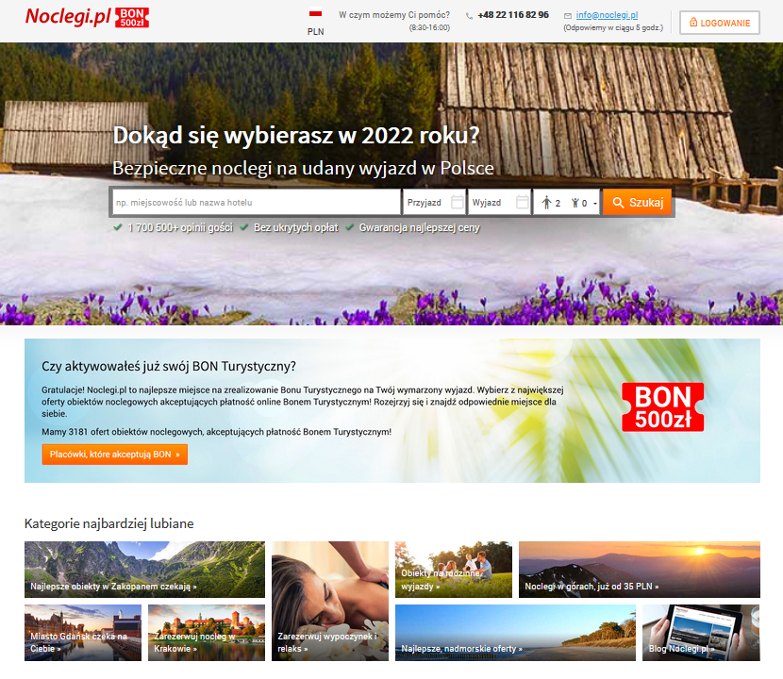
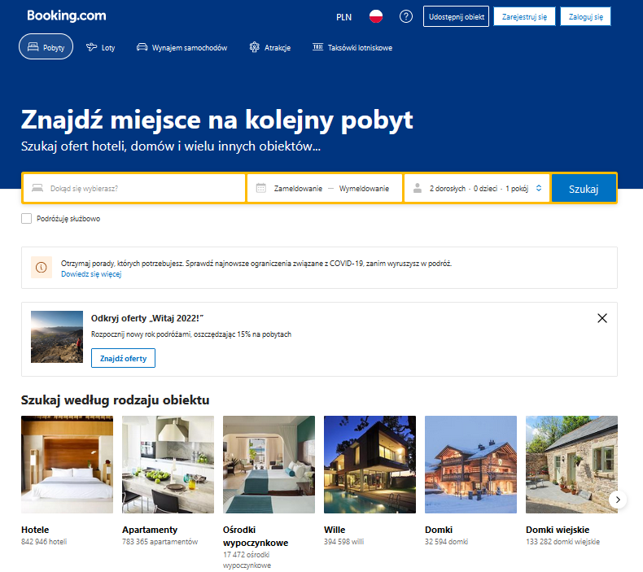
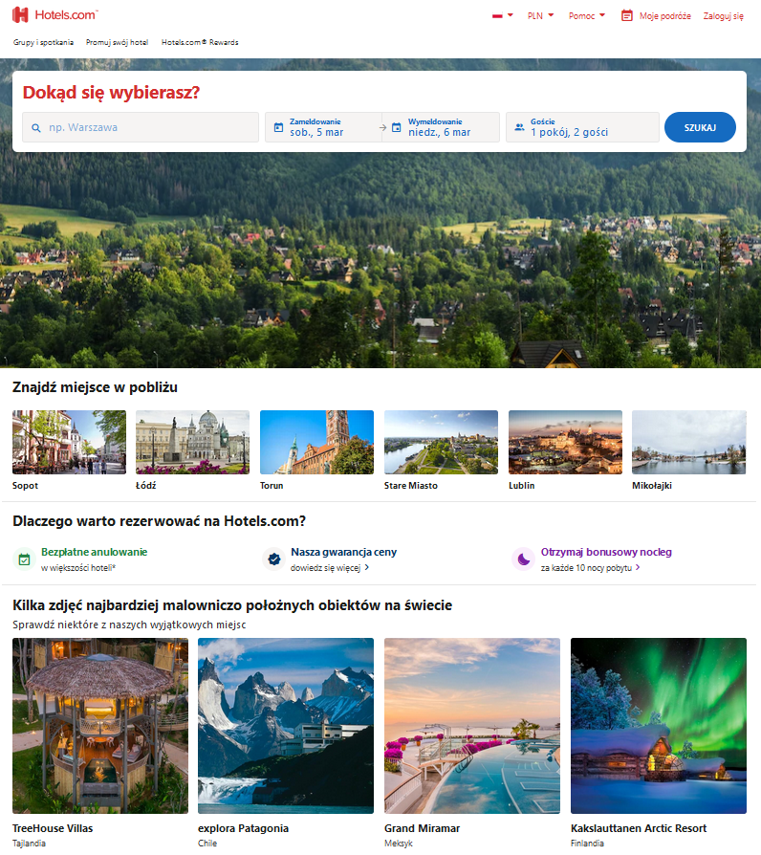
New data from booking sites - Web scraping
noclegi.pl
booking.com
hotels.com

Slide 9
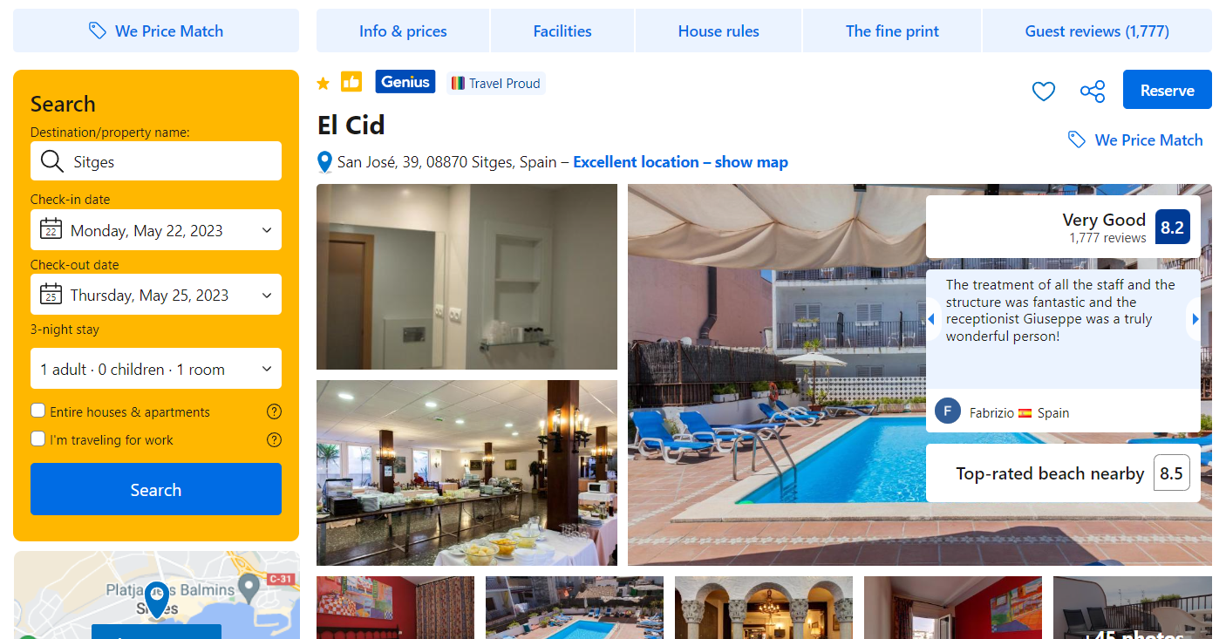
Scope of scraped data

Slide 10
Statistical Office in Rzeszów - Web scraping statistics
115 thus. records (50 MB)
3,4 mln records
(1,5 GB)
The web scraping process in the office is carried out daily using automatic triggers
daily
monthly

Slide 11

















Flow diagram for web scraping
Analysis of the catalogue of identified websites
Legal aspects
INPUT
Identifying tourism websites
Websites
Specialists in the field are needed - tourism
DATA PROCESSING
IT specialists and programmers needed
Database storing processed data
Cleaning and standardisation
Temporary database of acquired data
Implementation
OUTPUT
Mathematicians (quantitive methods) are needed
Data analysis

Slide 12

Processing and data linkage methods
(Tourism)

Slide 13
What to do with the scraped data?
Treat scraped data and survey separately.
Survey data is usually obtained often with a low disaggregation level and a delay reaching even a month.
Scraped data can be obtained without any delay and with a nice disaggregation level.
We can derive some statistics from scraped data and check whether they go with a line of survey statistics.
If true, scraped data statistics can serve for nowcasting or spatio-temporal disaggregation as indicators.
Merge scraped data and survey.
Survey data can be merged with scraped data with various techniques
Merging can increase coverage of survey frames
Merging can keep survey frames updated
Merging can provide additional variables

Slide 14
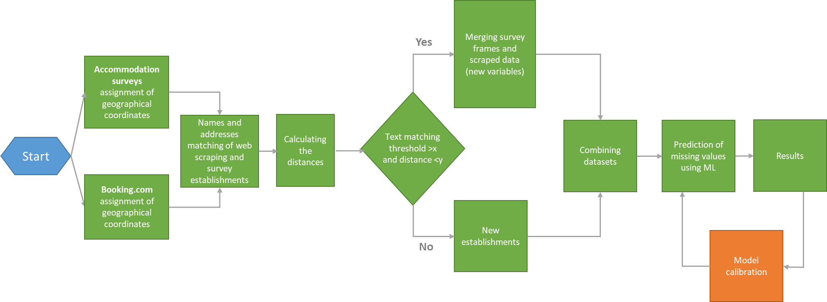
Diagram of the data processing based on booking.com
Notes:
Kluczowym elementem analizy i wykorzystania danych pozyskanych z webscrapingu jest powiązanie ich z danymi statystycznymi.
Wydaje się, że adres jest najprostszą metodą połączenia danych ale korzystanie ze skrótów w nazwach, błędy ortograficzne i różna składnia wywołuje olbrzymie trudności przy próbach scalenia danych.
W naszym wypadku zdecydowaliśmy się na skorzystanie z API, które pozwoliło nam ustrukturyzować zapis danych adresowych i nadać obiektom współrzędne geograficzne. Dzięki temu udało się zwiększyć jakoś łączenia danych.
Dzięki metodzie wyszukiwania rozmytego do sprawdzenia podobieństwa nazw obiektów. Udało nam się poradzić sobie z obiektami o wielu punktach adresowych lub obiektami które kierują pod jeden adres.
Po analizach został ustalony próg zbieżności i maksymalna odległość pomiędzy obiektami. W ten sposób udało nam się połączyć 60% obiektów z portalu booking z naszymi bazami.
Dla złączonych obiektów następnie przypisaliśmy liczbę turystów i noclegów i uzyskaliśmy w ten sposób nasz zbiór uczący dla przetestowania metod uczenia maszynowego aby zimputować brakujące dane i uzyskać tablice wynikowe.

Slide 15
Data linkage by geographical coordinates
Total: 18431*
Survey frame only: 14688
Survey frame and portal: 1719
Portal only: 2023
*lattitude and longitude properly retrieved

Slide 16
Data linkage
Confusion matrix
 |  | Actual
 | Total Population | Match (establishment is present in portals and survey frame) | Non-match (establishment is present in portals or survey frame)
Predicted | Match | true matches true positives (TP) | false matches false positives (FP)
 | Non-match | false non-matches false negatives (FN) | true non-matches true negatives (TN)

Slide 17
Data linkage
Confusion matrix
 |  | Actual
 | Total Population | Match (establishment is present in portals and survey frame) | Non-match (establishment is present in portals or survey frame)
Predicted | Match | TP = 774 | FP = 945
 | Non-match | FN = 151 | TN = 16561
Accuracy: 0,940

Slide 18
Data linkage
TP = 774 | FP = 945 | Precision 0,450 | False discovery rate 0,549
FN = 151 | TN = 16561 | False ommision rate 0,009 | Negative predictive value 0,991
Recall (TPR) 0,836 | False positive rate 0,054 | Positive likelihood ratio 15,5 | Diagnostic odds ratio 89,8
False negative rate 0,163 | Specificity 0,946 | Negative likelihood ratio 0,173 | F1 score 0,094

Slide 19
Flash estimates
Problem:
Survey results are available with t+30 delay
Preliminary regression results may be implausible
Results should be a count data – not continuous
Aim
Provide estimates of monthly data on tourists and nights spent for t+1

Slide 20

Flash estimates
Data
Tourist and nights spent with respect to residents, foreigners and total – survey results
Number of offers, mean price – scraped data
Method
Ordinary least squares
ARIMA
Notes:
TSA-Table 3 describes an additional important component of visitor expenditure and focuses on outbound tourism.
▪ It describes visitor expenditure on outbound tourism related to same-day visitors and tourists staying overnight, apart from that paid domestically before travelling abroad (see TSA-Table 2).

Slide 21
Flash estimates: tourists accommodated and nights spent at tourist accommodation establishments
Flash estimates
Web scraping of tourist accommodation websites
Flash estimates model
Survey statistics on accommodation establishments

Slide 22
Flash estimates: tourists accommodated and nights spent at tourist accommodation establishments
Flash estimates
Flash estimates model
Flash estimates model contains:
Bridge equations to derive monthly statistics from daily data from web scraping.
Time series model to obtain forecasts.

Slide 23
R - squared
Flash estimates
Region | Tourists |  |  | Nights spent
 | Total | Residents | Foreigners | Total | Residents | Foreigners
Pomorskie | 0,984 | 0,980 | 0,947 | 0,981 | 0,978 | 0,934
Podkarpackie | 0,620 | 0,623 | 0,536 | 0,654 | 0,655 | 0,566
Małopolskie | 0,872 | 0,670 | 0,869 | 0,653 | 0,470 | 0,883
Dolnośląskie | 0,925 | 0,837 | 0,912 | 0,827 | 0,722 | 0,923
Mazowieckie | 0,823 | 0,856 | 0,609 | 0,746 | 0,817 | 0,568

Slide 24
Temporal disaggregation
Aim
Disaggregate monthly data on tourists and nights spent to daily data
Preserve data consistency e.g.
relations between tourists and nights spent e.g. expected length of stay
Problems:
Our expectations on final results are usually limited to calendar effects
Preliminary regression results may be implausible
Results should be a count data – not continuous

Slide 25
Temporal disaggregation
Methods of regression:
LASSO (Least Absolute Shrinkage And Selection Operator)
Log-linear model (OLS)
Shrinkage of linear model (OLS)
Methods of benchmarking:
Denton’s additive approach
Denton’s multiplicative approach

Slide 26
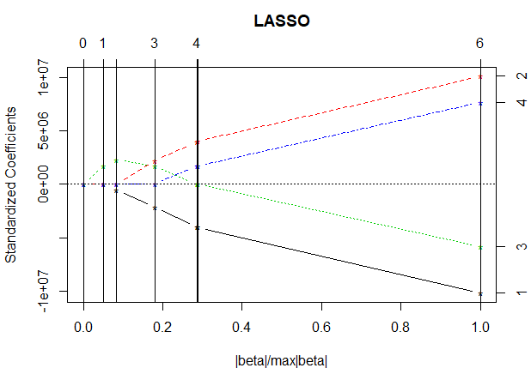
Temporal disaggregation
Variable selection plot for LASSO

Slide 27
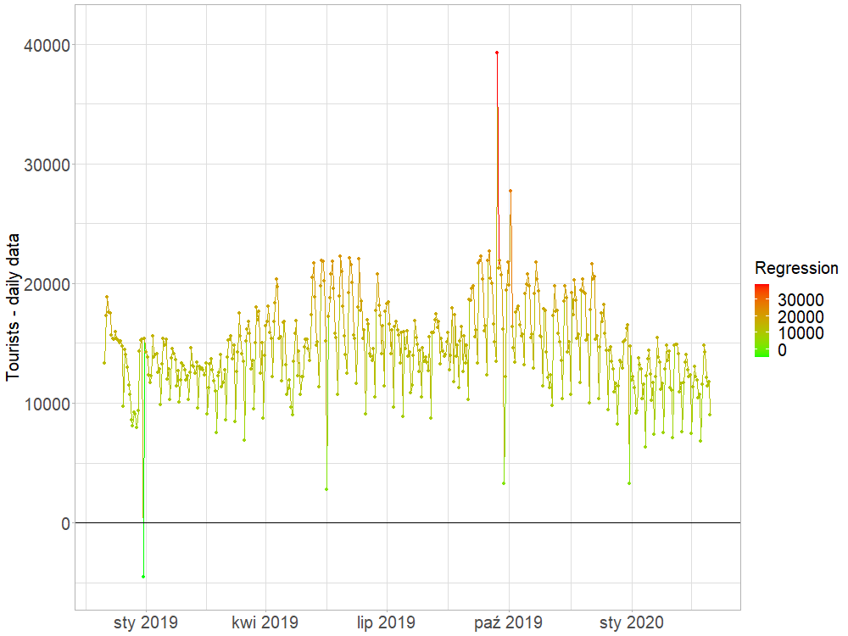
Temporal disaggregation
Shrinkage

Slide 28
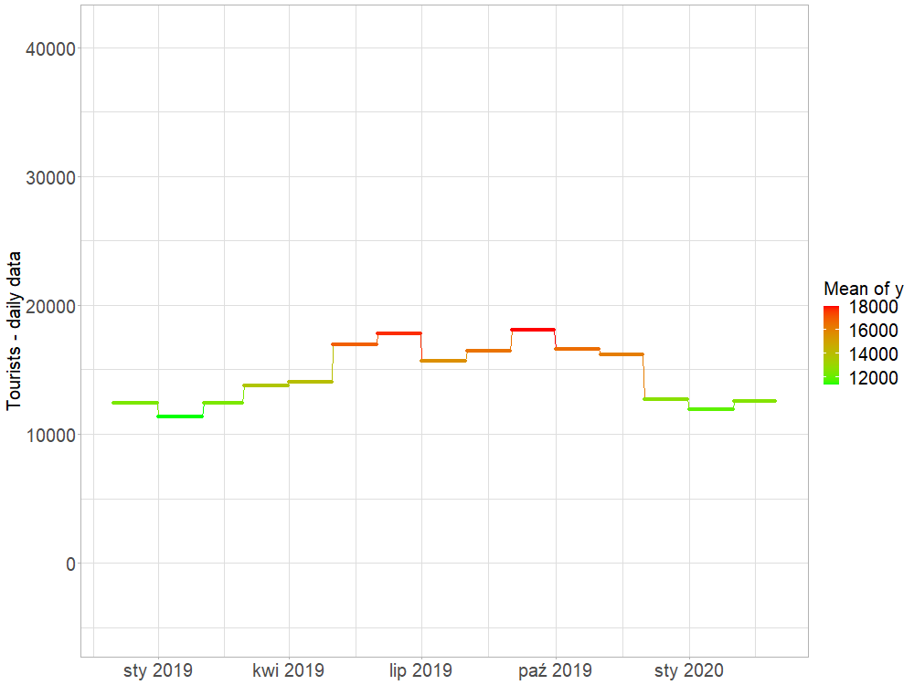
Temporal disaggregation
Shrinkage

Slide 29
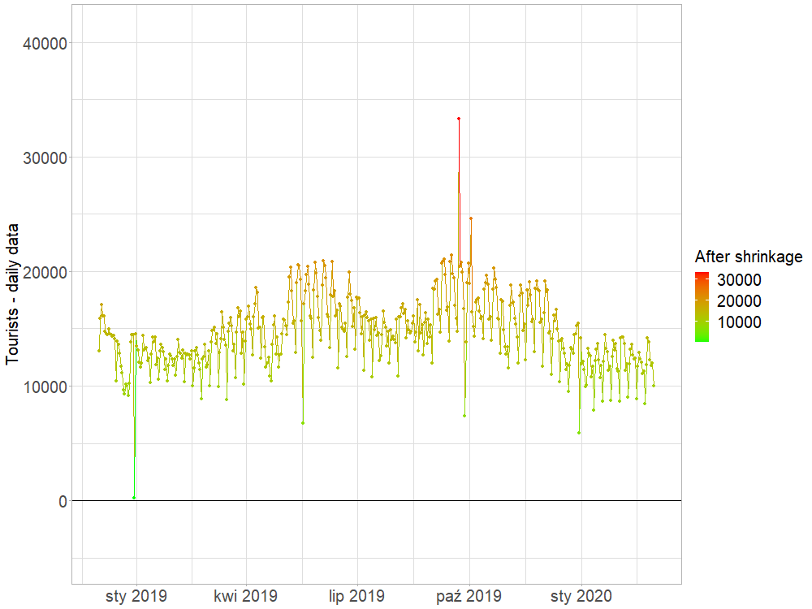
Temporal disaggregation
Shrinkage

Slide 30
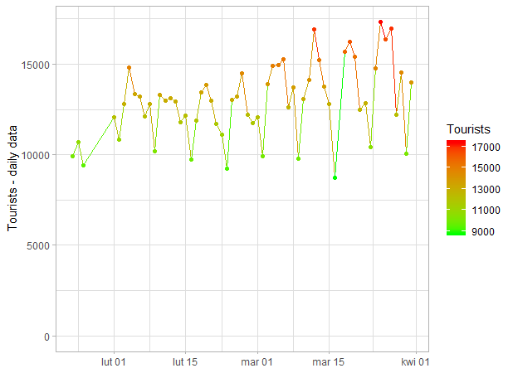
Temporal disaggregation
Calendar
effects
Visible periodicity

Slide 31
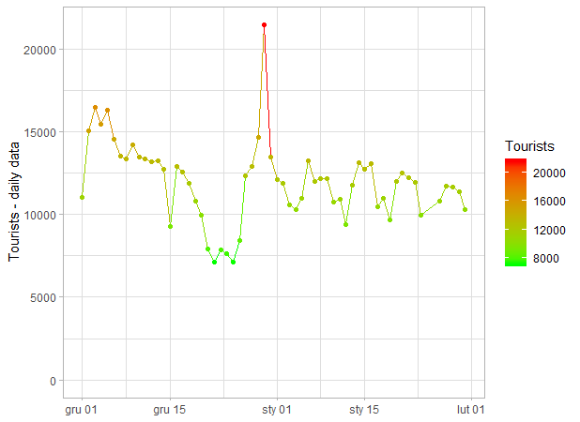
Temporal disaggregation
New Year’s Eve
Calendar
effects
Christmas
WPJ Innovative Tourism Statistics

Slide 32
Temporal disaggregation
R-squared (capital region - 15 periods, 3 variables)
Method | Tourists |  | Nights spent
 | Low Frequency | High Frequency | Low Frequency | High Frequency
LASSO | 0.9946 | 0.8910 | 0.0000 | 0.2448
Log-linear | 0.9992 | 0.3558 | 0.9993 | 0.2989
Shrinkage | 0.9952 | 0.8768 | 0.9927 | 0.8474

Slide 33
Temporal disaggregation
R-squared (our region - 15 periods, 3 variables)
Method | Tourists |  | Nights spent
 | Low Frequency | High Frequency | Low Frequency | High Frequency
LASSO | 0.9831 | 0.8822 | 0.9138 | 0.2939
Log-linear | 0.9996 | 0.2639 | 0.9996 | 0.2299
Shrinkage | 0.9890 | 0.8998 | 0.9751 | 0.7473

Slide 34
Updating survey frames of accommodation establishments
From Hotels.com and Booking.com there is collected data for 15000 accommodation establishments per month, including 5000 objects with below 9 places to stay.
In 2022, by using web scraping method, 239 new accommodation establishments was indified .

Slide 35
Airbnb and Booking
 | Rental income ( in zł) | Commission from owners (in zł) | Commission from renting guests (in zł) | Number of guests | Including non-residents | Average length of stay (number of nights) | Number of vacancies | Nights spend | Price per night (in zł)
POLAND | 475 632 064 | 21 666 957 | 58 194 512 | 4 562 379 | 344 221 | 2.37 | 134 397 | 1 599 598 | 268.74
DOLNOŚLĄSKIE | 44 220 715 | 2 323 567 | 4 902 427 | 416 898 | 25 193 | 2.97 | 12 686 | 172 053 | 257.02
KUJAWSKO-POMORSKIE | 22 149 673 | 1 185 722 | 2 419 625 | 245 406 | 5 721 | 3.47 | 6 649 | 95 584 | 231.73
LUBELSKIE | 11 392 469 | 644 042 | 1 188 340 | 142 565 | 3 787 | 2.72 | 4 065 | 53 495 | 212.96
LUBUSKIE | 4 265 143 | 225 244 | 470 983 | 43 840 | 4 081 | 2.32 | 1 608 | 17 215 | 247.76
ŁÓDZKIE | 10 937 426 | 472 273 | 1 380 898 | 127 513 | 3 036 | 2.52 | 4 452 | 41 972 | 260.59
MAŁOPOLSKIE | 87 179 691 | 4 167 139 | 10 344 886 | 795 340 | 58 203 | 3.17 | 19 824 | 284 782 | 306.13
MAZOWIECKIE | 59 848 062 | 1 959 659 | 8 582 536 | 587 279 | 116 279 | 2.43 | 18 604 | 173 870 | 344.21
OPOLSKIE | 2 814 546 | 100 936 | 389 197 | 37 886 | 1 524 | 2.44 | 1 595 | 11 843 | 237.65
PODKARPACKIE | 12 379 202 | 753 689 | 1 202 738 | 130 864 | 5 776 | 2.58 | 4 304 | 58 552 | 211.42
PODLASKIE | 7 526 231 | 482 070 | 692 041 | 85 087 | 3 458 | 2.76 | 2 694 | 33 827 | 222.49
POMORSKIE | 47 561 564 | 1 709 589 | 6 570 383 | 426 082 | 19 095 | 2.30 | 12 059 | 125 099 | 380.19
ŚLĄSKIE | 80 411 665 | 3 226 036 | 10 556 798 | 738 943 | 45 359 | 2.83 | 20 196 | 231 020 | 348.07
ŚWIĘTOKRZYSKIE | 6 627 536 | 392 157 | 662 573 | 85 901 | 2 664 | 3.00 | 2 550 | 33 654 | 196.93
WARMIŃSKO-MAZURSKIE | 11 841 071 | 987 352 | 712 583 | 106 389 | 5 276 | 2.55 | 4 262 | 62 119 | 190.62
WIELKOPOLSKIE | 31 617 014 | 1 556 896 | 3 676 750 | 286 054 | 16 024 | 2.43 | 12 272 | 105 903 | 298.55
ZACHODNIOPOMORSKIE | 34 860 055 | 1 480 588 | 4 441 753 | 306 332 | 28 745 | 3.51 | 6 581 | 98 610 | 353.51

Slide 36
Rentals – National Accounts
 | Real and contractual rents (in millions)
Gross value added | 476
Accommodation services used by residents and non-residents | 476
Intermediate consumption | 155
Products (breakfast, cleaning products) | 123
Fees for Airbnb and Booking paid by hosts | 22
Media costs | 10
Added value | 321
GDP –production side | 321
Import | 76
Fees for Airbnb and Booking paid by hosts and residents | 76
Export | 36
Accommodation used by non-residents | 36
Expenditures for consumption in households | 361
Accommodation used by residents | 440
Fees for Airbnb and Booking paid by residents | 54
Correction - costs incurred by hosts | -133
GDP – expenditure side | 321
Adjusting the present value of contractual rents reduces the value of GDP by PLN 28 million. Actual rents increase the value of GDP by PLN 321 million. The final impact on GDP value is PLN 293 million.

Slide 37

Thank you for your attention!
Sebastian Wójcik, PhD
Statistical Office in Rzeszów
s.wojcik@stat.gov.pl
Madrid, 6th July 2023

